Slide 1
Number guessing game in python 3 PyQt5
Train you self in PYQT5 library

Slide 2
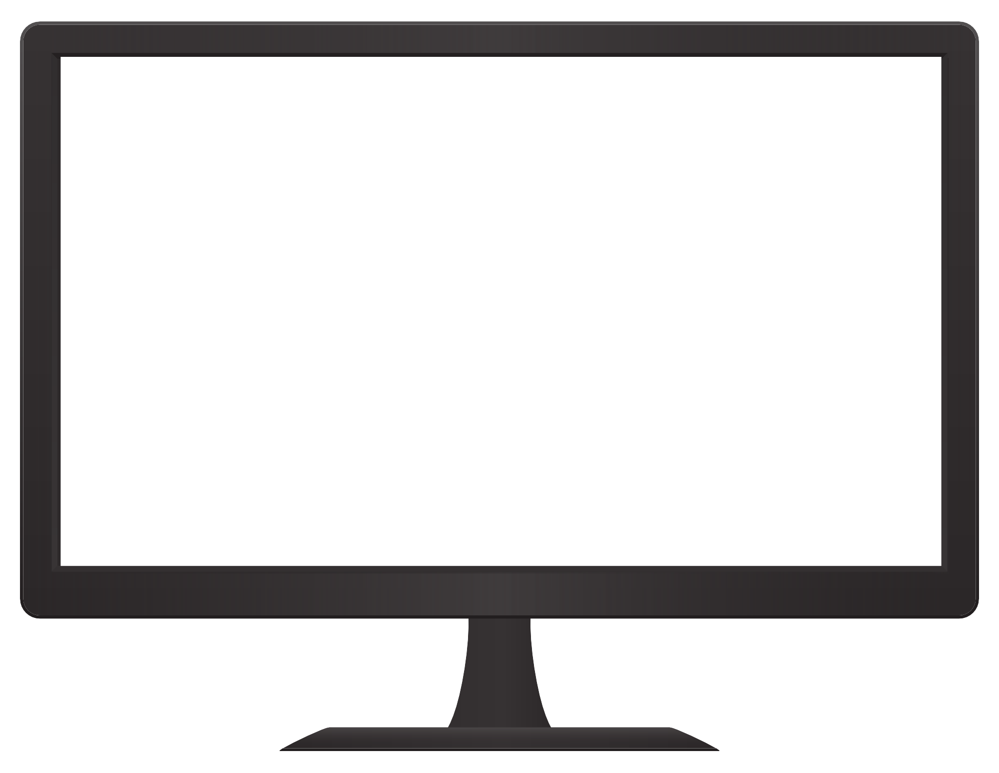
self.setGeometry(x = 0,y = 0, width = 400, Hight = 400)
Start window from X, y
Window width start from x and add 400 pixel to be end
Window Hight start from y and add 400 pixel to the end
Y = 0
Hight start = 0
X = 0
Hight end = 400
Width start = 0
width end = 400

Slide 3
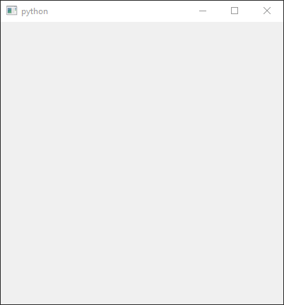
# import necessary libraries
from PyQt5.QtWidgets import *
from PyQt5.QtCore import *
from PyQt5.QtGui import *
import math
import random
import sys
# create class for our window
class Window(QMainWindow):
# initiate when start
def __init__(self):
# initiate window from parent class
super().__init__()
# setting geometry
self.setGeometry(100, 100, 400, 400)
# show window
self.show()
# in function widgets we will add user interface
# create application from qt5
app = QApplication(sys.argv)
#create instance of our window
window = Window()
#start application
sys.exit(app.exec())
Import necessary libraries
Initiate our game window
Assign geometry for it

Slide 4
# setting Title for our window
self.setWindowTitle("Number Guessing Game")
Change title for window
From python to Number Guessing Game

Slide 5
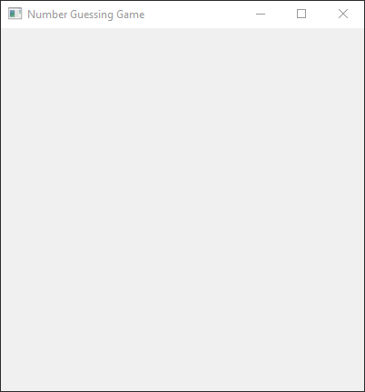
class Window(QMainWindow):
# initiate when start
def __init__(self):
# initiate window from parent class
super().__init__()
# setting geometry
self.setGeometry(0, 0, 400, 400)
# setting Title for our window
self.setWindowTitle("Number Guessing Game")
# show window
self.show()
Result

Slide 6
# setting background color
self.setStyleSheet("background-color : #7F27FF;")
Change background color

Slide 7
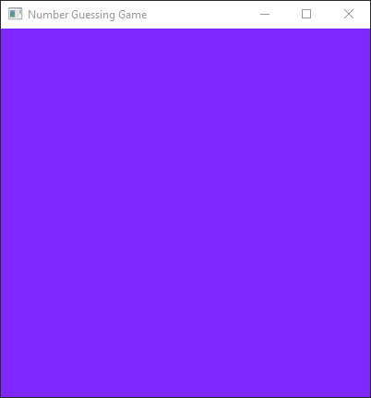
class Window(QMainWindow):
# initiate when start
def __init__(self):
# initiate window from parent class
super().__init__()
# setting geometry
self.setGeometry(0, 0, 400, 400)
# setting Title for our window
self.setWindowTitle("Number Guessing Game")
# setting background color
self.setStyleSheet("background-color : #7F27FF;")
# show window
self.show()
Result

Slide 8
# set head
self.head()
We will create new function called head
Adding our label to show information's to player
Result

Slide 9
# import necessary libraries
from PyQt5.QtWidgets import *
from PyQt5.QtCore import *
from PyQt5.QtGui import *
import math
import random
import sys
# create class for our window
class Window(QMainWindow):
# initiate when start
def __init__(self):
# initiate window from parent class
super().__init__()
# setting geometry
self.setGeometry(0, 0, 400, 400)
# setting Title for our window
self.setWindowTitle("Number Guessing Game")
# setting background color
self.setStyleSheet("background-color : #7F27FF;")
# set head
self.head()
# show window
self.show()
# in function head we will add label to interface showing information
def head(self):
# create application from qt5
app = QApplication(sys.argv)
#create instance of our window
window = Window()
#start application
sys.exit(app.exec())
Result

Slide 10
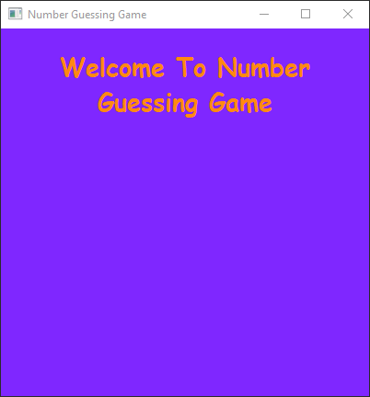
def head(self):
# create label and add message and assign it to work on our window
h = QLabel("Welcome To Number Guessing Game", self)
# setting head geometry in our window
h.setGeometry(20, 10, 360, 100)
# setting font for head and size
font = QFont("Comic Sans MS", 20)
# set font to be bold
font.setBold(True)
# set underline
font.setUnderline(False)
# set italic
font.setItalic(False)
# assign font to head label
h.setFont(font)
# set text wrap
h.setWordWrap(True)
# set color to our label
h.setStyleSheet("color : #FF8911;")
# set align to be middle
h.setAlignment(Qt.AlignCenter)
Add head with it’s properties

Slide 11
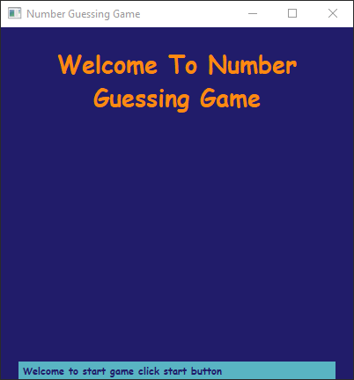
# in function info we will add label to interface showing information
def info(self):
# create label and add message and assign it to work on our window
info = QLabel("Welcome to start game click start button ", self)
# setting head geometry in our window
info.setGeometry(20, 380, 360, 30)
# setting font for head and size
font = QFont("Comic Sans MS", 8)
# set font to be bold
font.setBold(True)
# set underline
font.setUnderline(False)
# set italic
font.setItalic(False)
# assign font to head label
info.setFont(font)
# set text wrap
info.setWordWrap(False)
# set color to our label
info.setStyleSheet("border : 2px solid #FDBF60 ; color : red ; background-color : #9F70FD ;")
# set align to be middle
info.setAlignment(Qt.AlignLeft)
Result after adding info label

Slide 12
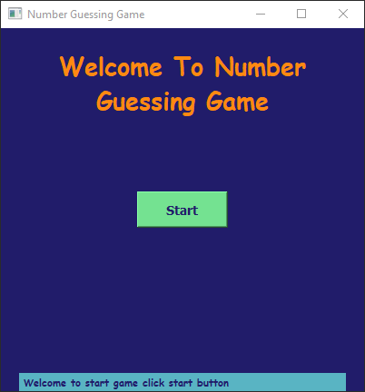
def start(self):
# add button to our window
start = QPushButton("Start", self)
#set geometry for our button
start.setGeometry(150, 180, 100, 40)
# set style
#"border-width : 2px ;" "border-style : outset ;""border-radius : 10px;" "border : #59B4C3 ;"
start.setStyleSheet("QPushButton" "{"
"background-color : #74E291 ;"
"color : #211C6A ;"
"font : bold 14px ;"
"}" )
start.clicked.connect(self.getint)
Result

Slide 13
def getint(self):
# get upper input in new dialog from user
i , okpressed = QInputDialog.getInt(self,"Upper Bound", "Please enter upper bound (0:100000): ", 0, 2, 100000, 1)
if okpressed:
# if user input integer number for upper bound ask for lower bound in new dialog
self.upper_bound = i
x, ok = QInputDialog.getInt(self,"Lower Bound","please enter lower bound (0:99999): ", 0, 0, 100000, 1 )
#if lower is greater than or equal upper range ask him to renter it again
while x >= i and ok:
x, ok = QInputDialog.getInt(self,"Lower Bound","please enter lower bound (0:99999): ", 0, 0, 99999, 1 )
# if got right number assigning to lower bound and calculate random number for pc
else:
#if got right number assigning to lower bound
self.lower_bound = x
# calculate random number for pc
self.pc_guess = random.randint(self.lower_bound, self.upper_bound)
# calculate attempts for player
self.attempts = round(math.log(self.upper_bound - self.lower_bound + 1, 2) - 2)
Here function will be called after click start button we ask user in separate window to input upper bound then enter lower bound and it must be lower than upper then generate random number and calculate attempts allowed to player

Slide 14
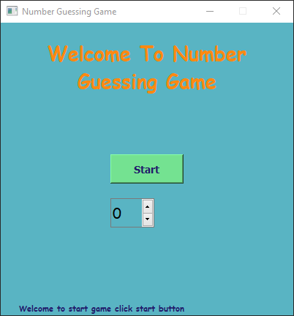
def spin_box(self):
#create spin box
self.spin_box = QSpinBox(self)
# set spin range lower and upper bound
self.spin_box.setRange(self.lower_bound, self.upper_bound)
# setting geometry to be above start button
self.spin_box.setGeometry(150, 240, 60, 40)
# setting font
self.spin_box.setFont(QFont("Comic Sans MS", 15))
Adding spin

Slide 15
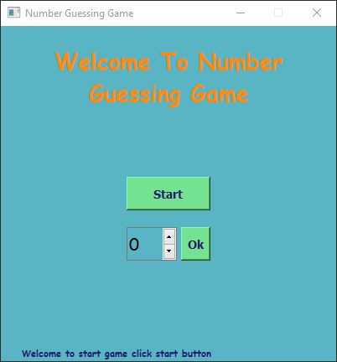
def player_guess(self):
# create button
player_guess = QPushButton("Ok", self)
# setting geometry to be above start button
player_guess.setGeometry(215, 240, 35, 40)
# set style
player_guess.setStyleSheet("QPushButton" "{"
"background-color : #74E291 ;"
"color : #211C6A ;"
"font : bold 14px ;"
"}" )
# adding action to the check button
player_guess.clicked.connect(self.check)
Result

Slide 16
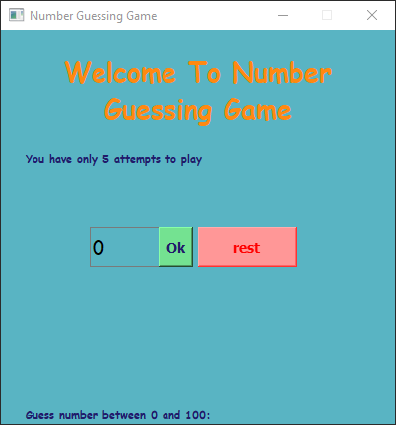
self.inf = QLabel("You have only {} attempts to play ".format(self.attempts), self)
self.inf.setGeometry(20, 120, 360, 60)
font = QFont("Comic Sans MS", 8)
# set font to be bold
font.setBold(True)
# set underline
font.setUnderline(False)
# set italic
font.setItalic(False)
# assign font to head label
self.inf.setFont(font)
# set text wrap
self.inf.setWordWrap(False)
self.inf.setAlignment(Qt.AlignCenter)
# set color to our label
self.inf.setStyleSheet("border : 2px solid #59B4C3 ; color : #211C6A ; background-color : #59B4C3 ;")
# set align to be middle
self.inf.setAlignment(Qt.AlignLeft)
self.inf.show()
To update information bar

Slide 17
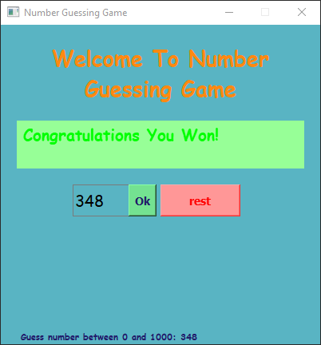
def check(self):
player_guessing = self.spin_box.value()
self.count += 1
if self.count < self.attempts:
if player_guessing == self.pc_guess:
self.inf = QLabel("Congratulations You Won! ", self)
self.inf.setGeometry(20, 120, 360, 60)
font = QFont("Comic Sans MS", 15)
# set font to be bold
font.setBold(True)
# set underline
font.setUnderline(False)
# set italic
font.setItalic(False)
# assign font to head label
self.inf.setFont(font)
# set text wrap
self.inf.setWordWrap(False)
self.inf.setAlignment(Qt.AlignCenter)
# set color to our label
self.inf.setStyleSheet("border : 2px solid #59B4C3 ; color : #211C6A ; background-color : #74E291 ;")
color_green = QGraphicsColorizeEffect()
color_green.setColor(Qt.red)
self.inf.setGraphicsEffect(color_green)
# set align to be middle
self.inf.setAlignment(Qt.AlignLeft)
self.inf.show()
To check wining conditions

Slide 18
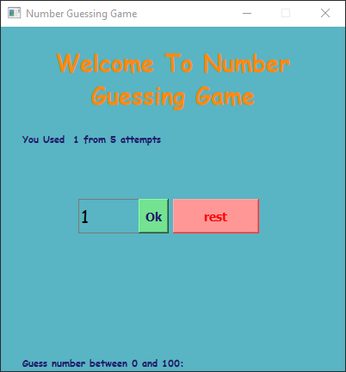
elif player_guessing > self.pc_guess or player_guessing < self.pc_guess :
self.inf = QLabel("You Used {} from {} attempts ".format(self.count, self.attempts), self)
self.inf.setGeometry(20, 120, 360, 60)
font = QFont("Comic Sans MS", 8)
# set font to be bold
font.setBold(True)
# set underline
font.setUnderline(False)
# set italic
font.setItalic(False)
# assign font to head label
self.inf.setFont(font)
# set text wrap
self.inf.setWordWrap(False)
self.inf.setAlignment(Qt.AlignCenter)
# set color to our label
self.inf.setStyleSheet("border : 2px solid #59B4C3 ; color : #211C6A ; background-color : #59B4C3 ;")
# set align to be middle
self.inf.setAlignment(Qt.AlignLeft)
self.inf.show()
To update info conditions

Slide 19
def rest(self):
rest = QPushButton("rest", self)
#set geometry for our button
rest.setGeometry(200, 200, 100, 40)
# set style
#"border-width : 2px ;" "border-style : outset ;""border-radius : 10px;" "border : #59B4C3 ;"
rest.setStyleSheet("QPushButton" "{"
"font : bold 14px ;"
"}" )
color_red = QGraphicsColorizeEffect()
color_red.setColor(Qt.red)
rest.setGraphicsEffect(color_red)
rest.clicked.connect(self.getint)
To add rest button

